Slide 1



UNIT RENEWAL
2027 RESOURCES

Slide 2





Membership Renewal and Unit Renewal started in 2024. Unlike the previous annual "rechartering" process, these two new processes are completely separate and serve different purposes.
UNIT RENEWAL
OCCURS ANNUALLY
The Unit Renewal process started in 2024, to renew or extend the agreement
with the Chartering Organization to operate the unit for another year. Through this process, a member of the Key 3 logs into my.scouting.org to validate Safeguarding Youth Training and Criminal Background Checks for all adult leaders and then pays the annual renewal fee.
When the online process has concluded, the Atlanta Area Council requires all parties to complete the Annual Charter Agreement form to fully complete the annual renewal process.
FEES
$100 = Unit Renewal Fee
MEMBER RENEWAL
OCCURS MONTHLY
Beginning August 1, 2023, new members
paid the full annual membership fee upon initial registration. At this time, all memberships are renewed every twelve months upon their initial registration anniversary.
This applies to all youth, adults, and merit badge counselors registered in Scouting.
FEES
$85 = Cub Scouts, Scouts BSA, Venturing, Sea Scout participants
$50 = for Exploring participants
$65 = all adult volunteers
$25 = all merit badge counselors
(fee only applies to merit badge counselors who are not already registered as leaders)
Unit Renewal and Membership Renewal are separate processes.

Slide 3


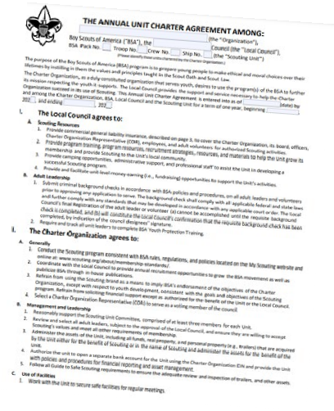
STEP 1: RECEIVE NOTIFICATION
The Unit Key 3 (Chartered Organization Representative, Unit Committee Chair, Unit Leader) and the CR Delegate will receive renewal notification from the system sixty days (two months) prior to the charter expiration date.
STEP 2: LOG ON
Access the online Unit Renewal system through my.scouting.org. A member of the unit Key 3 logs into my.scouting.org and clicks on Organization Manager then Unit Renewal. Only members of the Unit Key 3 can process the renewal, Key 3 Delegates do not have access to submit the renewal.
STEP 3: REVIEW ROSTER
1. This step triggers an automatic validation of the charter. To pass, you must have:
ADULT LEADER POSITION REQUIREMENTS:
Packs = CR, Pack Committee Chair, Cubmaster, at least 2 Committee Members, and at least 1 Den Leader.
Troops, Crews, Ships, and Post = CR, Unit Committee Chair, unit leader (SM or equivalent), and at least 2 Committee Members.
Family Cub Scout Packs, female Scouts BSA Troops, and co-ed Sea Scout Ships, Explorer Posts, and Venturing Crews, must have at least 1 registered female leader.
The CR can also serve as CC or MC
At least 5 youth
Correct adult leaders
SYT for those adults
Background checks completed
2. Review the Unit Leadership section. To edit positions:
The Chartered Organization Representative (CR) can click Edit Positions to change positions during the Unit Renewal process.
*Only CRs can make position changes online*
Unit Leaders and Committee Chairs cannot make these changes online. We recommend turning in applications for changes prior to beginning the Unit
Renewal process.
3. Then the person completing the Unit Renewal process (e.g., Key 3 member or CR Delegate) must input their name in the Unit Renewal and Leadership Approval section and then click the Next Step button in the bottom right.
STEP 4: PAY
To renew by credit card or ACH (Check) payment online:
  There will be a summary page showing totals and directs the unit to pay. Please note: there is an ACH Payment fee of
$1.00 or a Credit Card fee of 3%.
  Review “Renewal Order Status” page and print a copy of this page if a receipt is needed.
  Click the “Go To Confirmation” button in the lower right. The system will show that the payment is being processed and that the Unit Renewal order has been submitted.
To renew and pay at the council office via check or cash only:
  Click “Click here for Pay at the Council Office Option” at the bottom of the page. Here you can download a report and submit payment at the Atlanta Area Council office or via mail to 1800 Circle 75 Pkwy SE, Atlanta, Ga. 30339
STEP 5: COMPLETE ANNUAL CHARTER AGREEMENT*
Download, fill out, and print the Annual Unit Charter Agreement.
Review the Annual Unit Charter Agreement and have it signed by the following people:
  Charter Organization (Executive Officer) - The name of the Executive Officer can be found in My.Scouting.org. Organization Manager > Position Manager > Registered Positions.
Charter Organization Representative (CR)
Unit Committee Chair
Local BSA Council (District Professional)
3. Return to the Atlanta Area Council, via:
Dropping off at the Atlanta Area Council office
Mail to 1800 Circle 75 Pkwy SE, Atlanta, Ga. 30339
Email to donna.carr@scouting.org
3

Slide 4

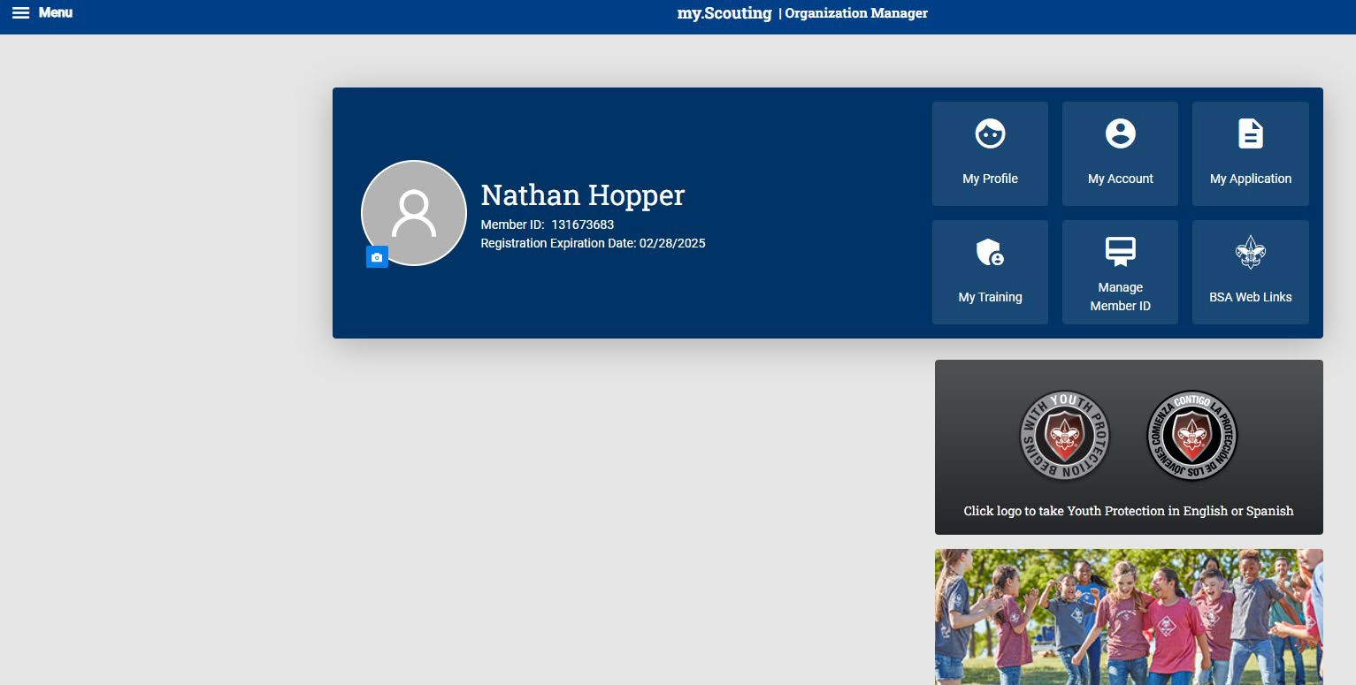

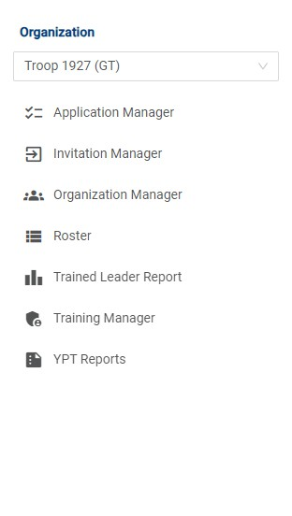



UNIT RENEWAL
STEP 1: Log in to my.scouting.org
STEP 2: Click on the Menu button and select Organization Manager

Slide 5

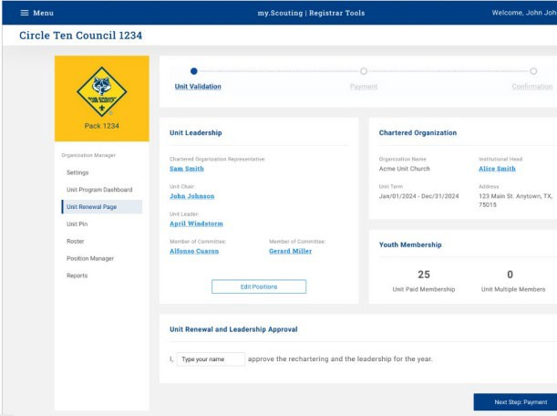





UNIT RENEWAL (continued)
STEP 3: Click Unit Renewal Page
STEP 4: Validate. This triggers an automatic validation of the charter. To pass, you must have:
At least 5 youth
Correct adult leaders
SYT for those adults
Background checks completed*
*The background check form must be on file, PLUS the actual background check must be completed and clean!

Slide 6

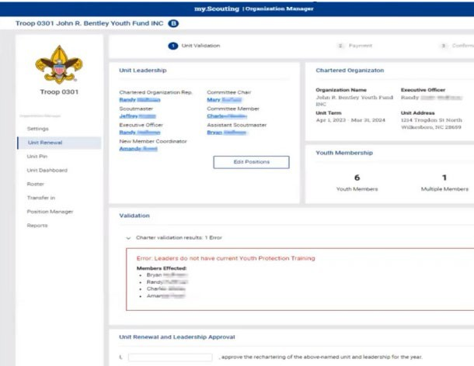




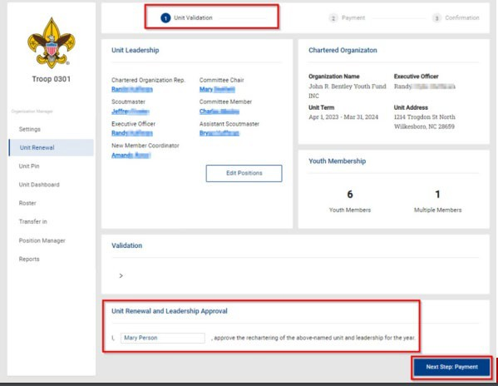



UNIT RENEWAL (continued)
If an error is detected during validation, you will be notified in the error box. Fix the errors and try again.
STEP 5: When there are no errors showing in the validation area:
Type your name to Approve the click Continue to Payment to pay.
7

Slide 7

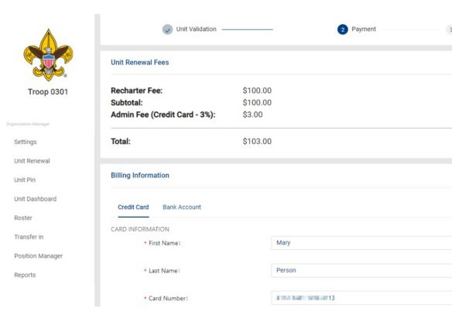



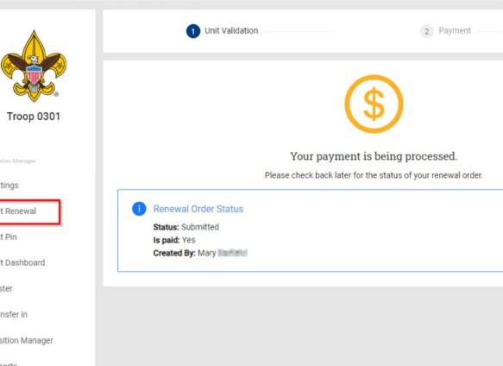

UNIT RENEWAL (continued)
Step 6: Enter payment information.
If you selected the “Pay-at-Council” option, you will get a different screen with instructions.
Success!

Slide 8
FREQUENTLY ASKED QUESTIONS - UNIT RENEWAL
When can a unit begin the renewal process?
The recharter system opens for all units on
11/1/2026
Who can submit the Unit Renewal?
The Charter Organization Rep, Committee Chairman, or Unit Leader are the only positions that can submit the Unit Renewal.
When are Unit Renewals due?
Unit Renewals are due
12/31/2026
Are we required to pay online?
No, there is an option to pay at the council office. Units can pay for the recharter in several ways:
By credit card online: units will have to pay 3% a processing fee.
By e-check online: units will have to pay a $1 processing fee.
Mailing a check to Atlanta Area Council at 1800 Circle 75 Pkwy SE, Atlanta, Ga. 30339
Delivering a check to the Atlanta Area Council Volunteer Service Center
Can we pay for unit renewals using a credit card at the council office?
We recommend paying with cash or check for all renewals to the Atlanta Area Council. Any credit card transactions will be charged a 3% credit card processing fee at the Atlanta Area Council. Debit cards will not be charged a fee.
Do we print out the charter paperwork and have the Chartered Organization Representative sign it?
No. With the new Unit Renewal process, there is no step to submit physical paperwork to the Chartered Organization to approve it.
We need to change adult leadership positions within the unit. Can this take place during the Unit Renewal process?
Only the Chartered Organization Representative (CR) can make changes to adult leadership positions online during the renewal process. Unit Leaders and Committee Chairs cannot make these changes online. We recommend turning in applications for changes prior to beginning the Unit Renewal process.
Still have questions or need help?
You can reach out to your District Professional (click here for our staff directory) , District Commissioner, Council Registrar (click here) or the Council Office (770-989-8820)

