Slide 1



MEMBER RENEWAL
2027 RESOURCES

Slide 2











There are two options for individuals to renew their Scouting America membership:
OPTION 1: INDIVIDUAL RENEW REGISTRATION
Beginning 60 days before their expiration date, individuals will receive communication from the National Council that will prompt them to renew their registration. To renew this way, individuals can either renew online or manually with the Atlanta Area Council. See below for instructions.
Renew online at my.scouting.org
  Click on the link in the email that will direct individuals to my.scouting.org to renew their registration. You can also go to my.scouting.org and click the red notification button in the top right-hand corner.
  This will direct individuals to pay online and renew their registration in a few clicks.
Manually renew at the Atlanta Area Council
  Print out the Manual Payment form generated from my.scouting.org and submit with payment to the Atlanta Area Council in person or via mail: 1800 Circle 75 Pkwy SE, Atlanta, Ga. 30339
Important Info:
Parents will have to create a my.scouting.org account if they do not have one already.
Parents with multiple Scouts will only need to create one account, as my.scouting.org has already linked their Member ID with all of their children. If parents discover this has not happened, simply contact the Atlanta Area Council 770-989-8820 or donna.carr@scouting.org o.
OPTION 2: UNIT RENEWS INDIVIDUAL
Using this method, individuals can pay the unit, and the unit can renew registrations on their behalf. This is ideal for units that pay for renewals through funds from the popcorn or camp card sales. To renew this way:
A member of the unit Key 3 logs into my.scouting.org and clicks on Organization Manager, then Roster.
To renew by credit card or ACH payment online:
  The unit leadership selects members who are eligible to renew and then simply clicks Renew in the header bar.
  There will be a summary page showing totals and directing the unit to pay. Please note: there is an ACH Payment fee of $1.00 or a Credit Card fee of 3%.
To renew and pay at the council office via check or cash:
  The unit leadership selects members who are eligible to renew and then simply clicks Print in the header bar and then clicks Unit Payment of Membership Renewal. Here you can download a report and submit payment at the Atlanta Area Council office or via the mail: 1800 Circle 75 Pkwy SE, Atlanta, Ga. 30339.
Important Info:
Units can only renew members beginning three months before their expiration date..
Units can complete this process at any time and as many times as they want! This means that if units are waiting on payment from individuals, they can come back and renew them once payment is made to the unit.
Units can also Opt-Out a member from renewing if they have left the unit.
You can also see a person’s multiple registrations by clicking Show Multiple Registrations. To continue with the renewal, click
Create Renewal Orders.
Remember, all renewals are for 12 months and begin the day after the expiration date of the current registration.
Members will need to log into their own my.scouting.org account and renew their Multiple (other non-paid) registrations in order to continue in those positions or have the other unit renew those Multiple positions
10

Slide 3




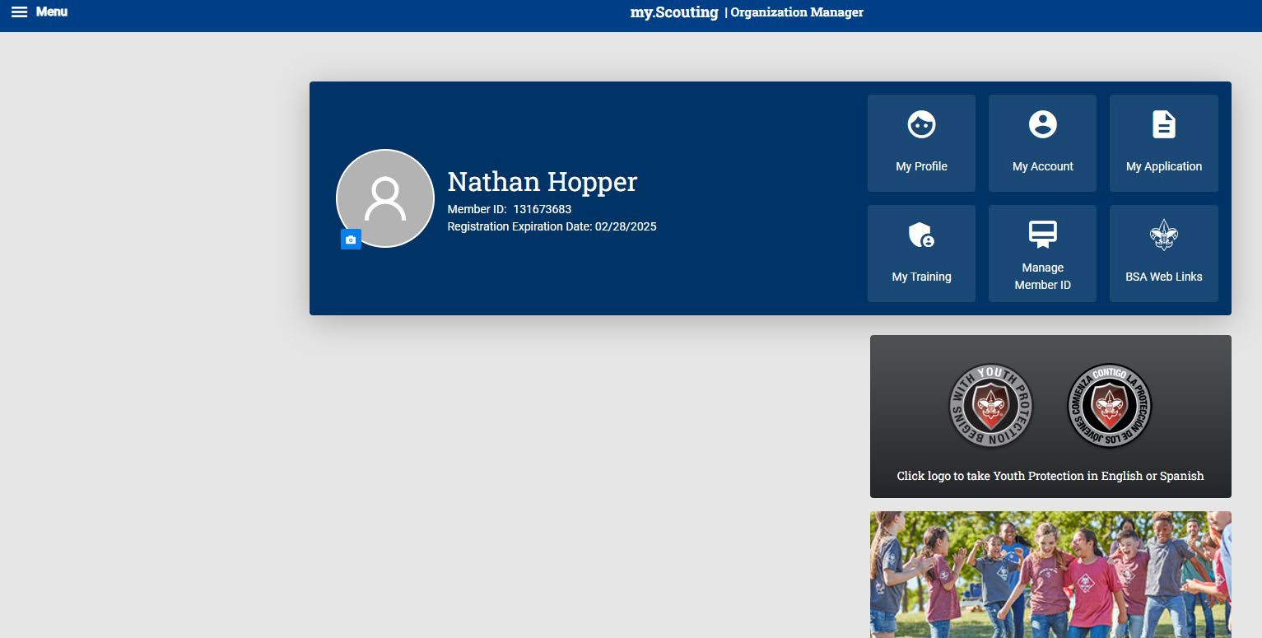
OPTION 1: INDIVIDUALS RENEW REGISTRATION
WHEN PAYING ONLINE WITH CREDIT CARD
Beginning 60 days before their expiration date, individuals will receive communications from the National Council that will prompt them to renew their registration. To renew this way, simply:
Click on the link in the emails that will direct individuals to my.scouting.org to renew the registration. You can also go to my.scouting.org and click the red notification button in the top right-hand corner.
This will direct individuals to pay online and renew their registration in a few clicks.
STEP 1: Log in to my.scouting.org and click on the red notification icon in the top right corner.

Slide 4
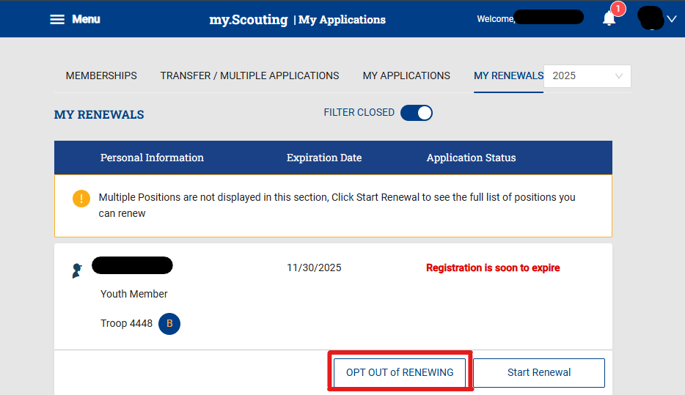

OPTION 1: INDIVIDUALS RENEW REGISTRATION
WHEN PAYING ONLINE WITH CREDIT CARD
Members can OPT OUT of renewing by selecting the “OPT OUT of RENEWING” button

Slide 5

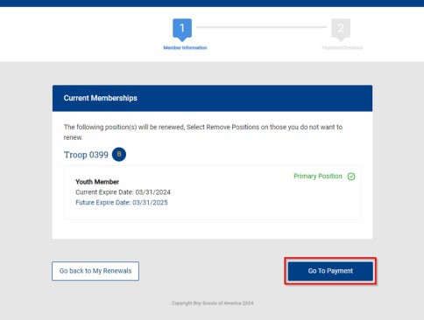




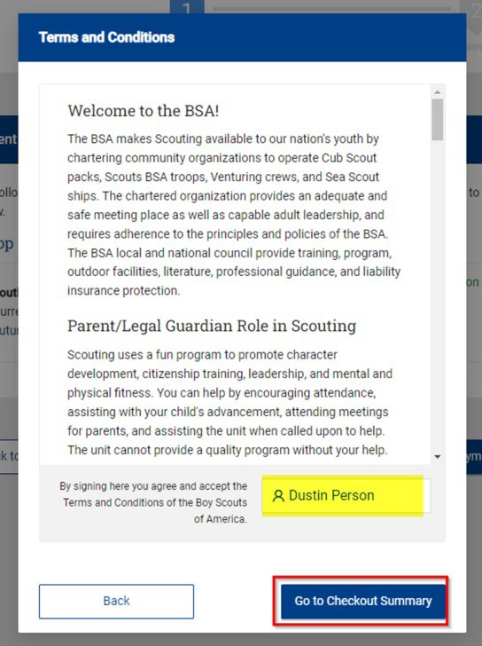



OPTION 1: INDIVIDUALS RENEW REGISTRATION (continued)
WHEN PAYING ONLINE WITH CREDIT CARD
STEP 2: A pop-up will display, showing the registration(s) to be renewed. If adults have Multiple registrations in other units, it will show here.
For adults: a popup will display that will require an acknowledgement that they agree with the Terms and Conditions.

Slide 6

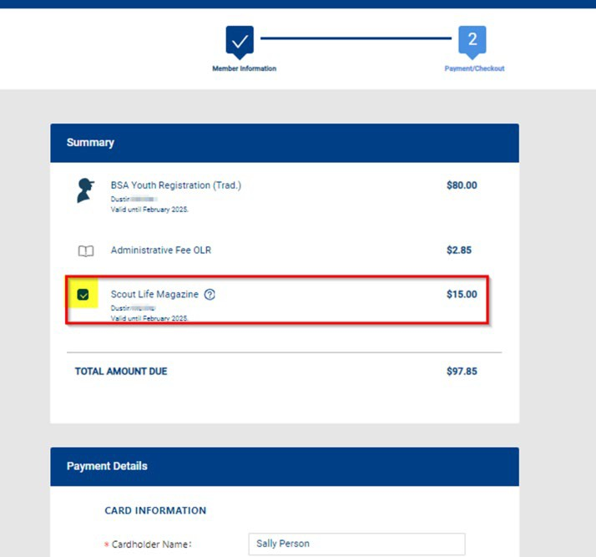


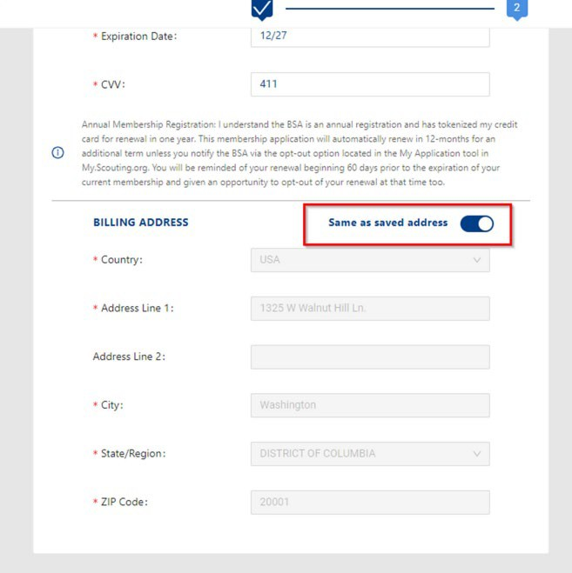


OPTION 1: INDIVIDUALS RENEW REGISTRATION (continued)
WHEN PAYING ONLINE WITH CREDIT CARD
STEP 3: Proceed to check out. Note: The default is to subscribe to Scout Life. You will need to uncheck the box if you do not wish to subscribe.
STEP 4: Proceed to pay.
Individuals can pay online by selecting Place Order. Or select Click to print for manual pay to pay the council or to pay the unit.
14

Slide 7

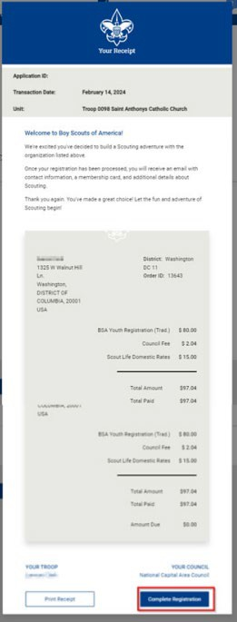


OPTION 1: INDIVIDUALS RENEW REGISTRATION (continued)
Individual Registration Renewal Process
WHEN PAYING ONLINE WITH CREDIT CARD
STEP 5: Once the Credit Card process is completed, your receipt will show. Click on the “Complete Registration”
Tab at the bottom and you will be directed back to your applications in My.Scouting.

Slide 8
OPTION 1: INDIVIDUALS RENEW REGISTRATION
Individual Registration Renewal Process
WHEN PAYING DIRECT TO THE Atlanta Area COUNCIL
Beginning 60 days before their expiration date, individuals will receive communications from the National Council that will prompt them to renew their registration. To renew this way, simply:
Click on the link in the emails that will direct individuals to my.scouting.org to renew the registration. You can also go to my.scouting.org and click the red notification button in the top right-hand corner.
This will direct individuals to pay online and renew their registration in a few clicks.
STEP 1: Log in to my.scouting.org and click on the red notification icon in the top right corner.

Slide 9



OPTION 1: INDIVIDUALS RENEW REGISTRATION (continued)
Individual Registration Renewal Process
WHEN PAYING DIRECT TO THE Atlanta Area COUNCIL
STEP 2: A pop-up will display showing the registration(s) to renew. If adults have Multiple registrations in other units, it will show here.
For adults: a pop-up will display that will require an acknowledgment that they agree with the Terms and Conditions.

Slide 10
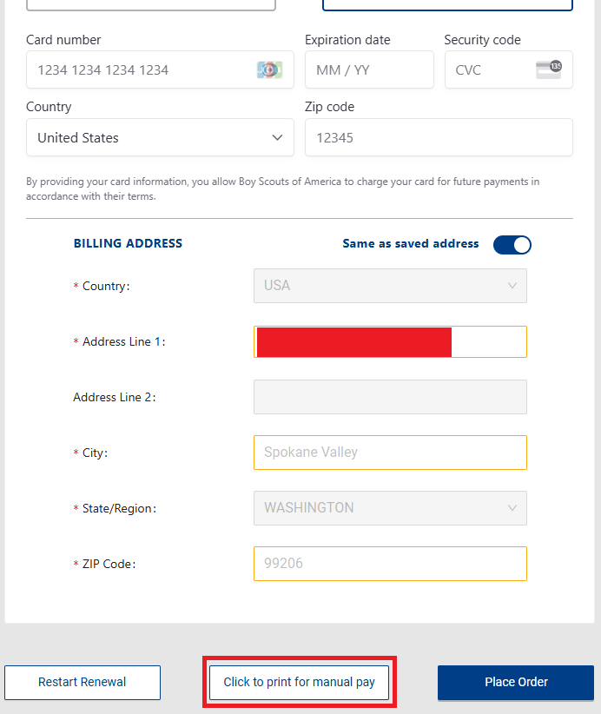


OPTION 1: INDIVIDUALS RENEW REGISTRATION (continued)
Individual Registration Renewal Process
WHEN PAYING DIRECT TO THE Atlanta Area COUNCIL
STEP 3: Proceed to check out. Note: The default is to subscribe to Scout Life. You will need to uncheck the box if you do not wish to subscribe.
STEP 4: Proceed to pay.
Individuals can select Click to print for manual pay to pay the council or to pay the unit.
18

Slide 11

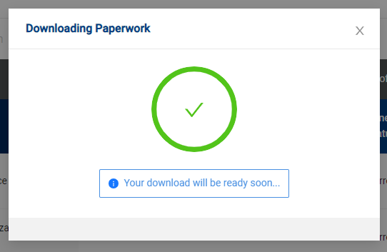



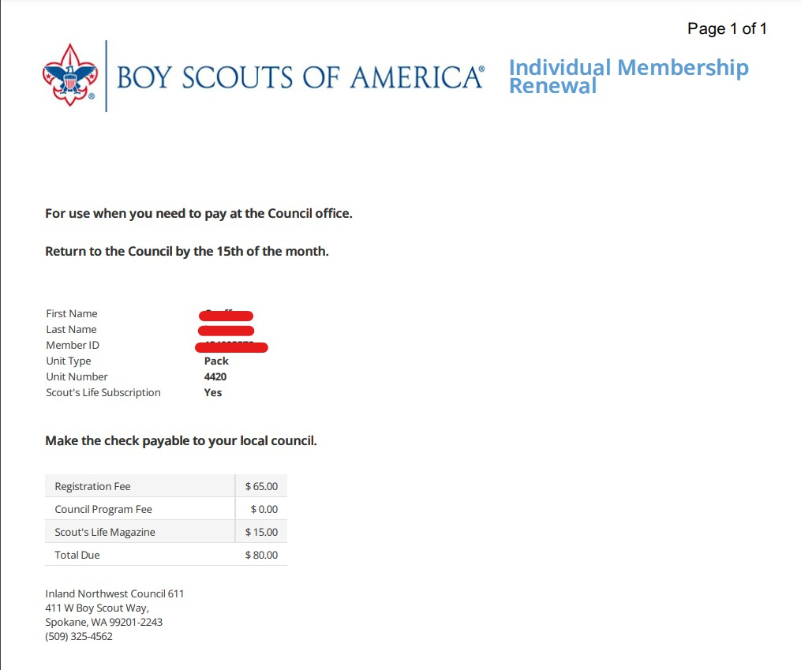




OPTION 1: INDIVIDUALS RENEW REGISTRATION (continued)
Individual Registration Renewal Process
WHEN PAYING DIRECT TO THE Atlanta Area COUNCIL
STEP 5: A pop-up will display that the paperwork is downloading
STEP 6: Submit this paperwork and payment to the Atlanta Area Council. See below for more details.
Deliver check or cash along with this printout directly to the Atlanta Area Council Service Center, or mail to:
Atlanta Area Council
1800 Circle 75 Pkwy SE, Atlanta, GA 3033
19

Slide 12


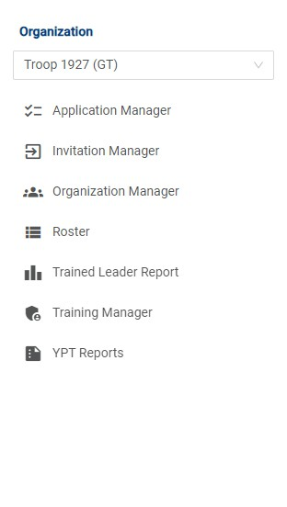



OPTION 2: UNIT RENEWS INDIVIDUAL
Individual Registration Renewal Process
WHEN PAYING ONLINE WITH CREDIT CARD OR ACH PAYMENT
STEP 1: Log in to my.scouting.org
STEP 2: Click on the Menu button and select Organization Manager

Slide 13

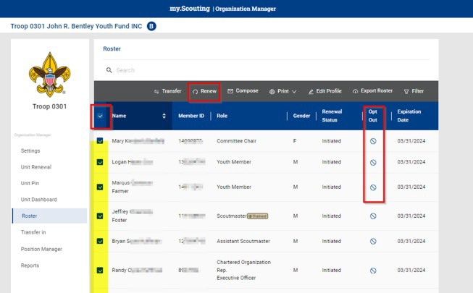









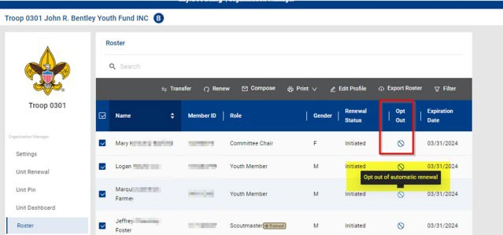


OPTION 2: UNIT RENEWS INDIVIDUAL (continued)
Individual Registration Renewal Process
WHEN PAYING ONLINE WITH CREDIT CARD OR ACH PAYMENT
STEP 5: Click renew to renew selected members
STEP 3:
Click on
Roster
STEP 4: Select members to renew
STEP 6: You can also opt-out members who are no longer in Scouting

Slide 14



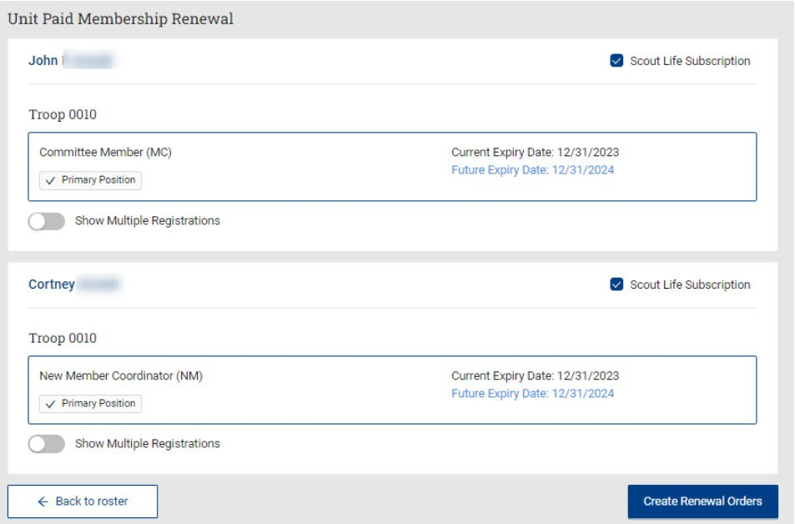

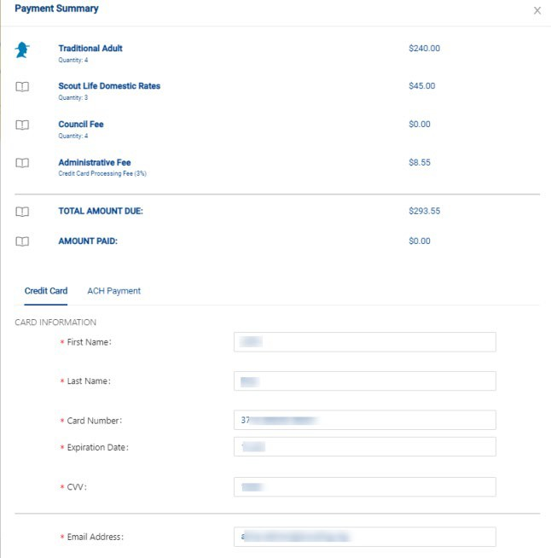


OPTION 2: UNIT RENEWS INDIVIDUAL (continued)
Individual Registration Renewal Process
WHEN PAYING ONLINE WITH CREDIT CARD OR ACH PAYMENT
STEP 7: A list of the members you are renewing displays.
NOTE: Scout Life will be selected by default. If you have members who do not want to subscribe, uncheck the box.
You can also see a person’s multiple registrations by clicking “Show Multiple Registrations”. To continue with the renewal, click Create Renewal Orders.
STEP 8: Enter payment information. The ACH Payment admin fee is
$1.00; the Credit Card admin fee is 3%.

Slide 15

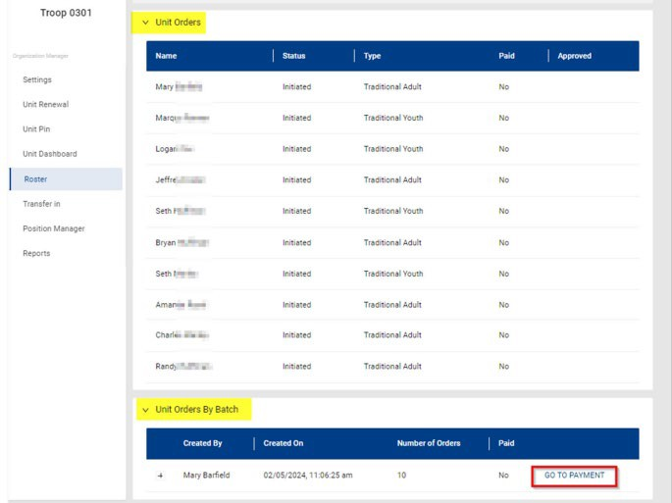



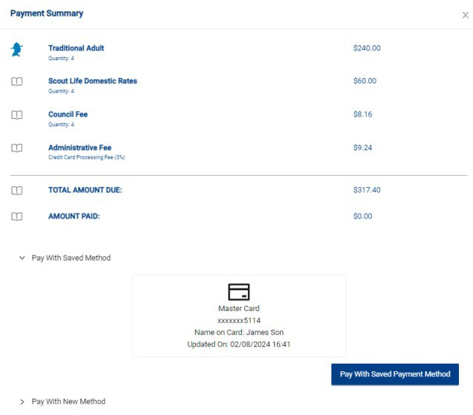

OPTION 2: UNIT RENEWS INDIVIDUAL (continued)
Individual Registration Renewal Process
WHEN PAYING ONLINE WITH CREDIT CARD OR ACH PAYMENT
STEP 9: Go back to Roster. Then select Unit Orders and/or Unit Orders by Batch. Then click Go to Payment.
STEP 10: Submit payment.
23

Slide 16
OPTION 2: UNIT RENEWS INDIVIDUAL (continued)
Individual Registration Renewal Process
WHEN PAYING ONLINE WITH CREDIT CARD OR ACH PAYMENT
STEP 1: Log in to my.scouting.org
STEP 2: Click on the Menu button and select Organization Manager

Slide 17

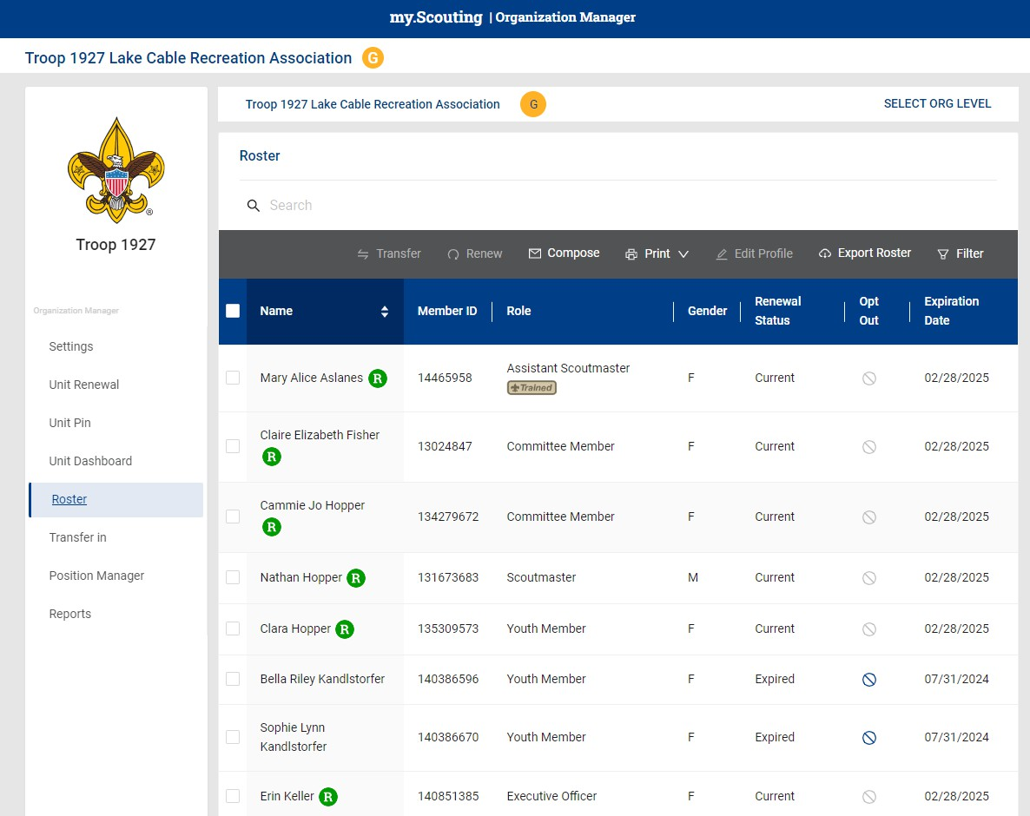


OPTION 2: UNIT RENEWS INDIVIDUAL (continued)
Individual Registration Renewal Process
WHEN PAYING DIRECTLY TO THE Atlanta Area COUNCIL
STEP 3:
Click on
Roster
Renewing Scout #1
Renewing Scout #2

Slide 18
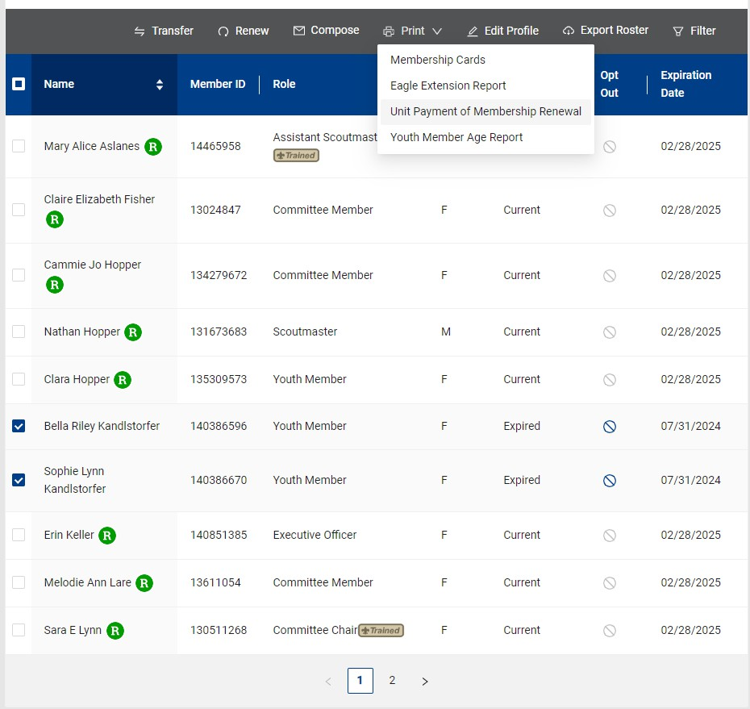






OPTION 2: UNIT RENEWS INDIVIDUAL (continued)
Individual Registration Renewal Process
WHEN PAYING DIRECTLY TO THE Atlanta Area COUNCIL
STEP 5: Click Print then click Unit Payment of Membership Renewal
STEP 4: Select Scouts for renewal
Renewing Scout #1
Renewing Scout #2

Slide 19


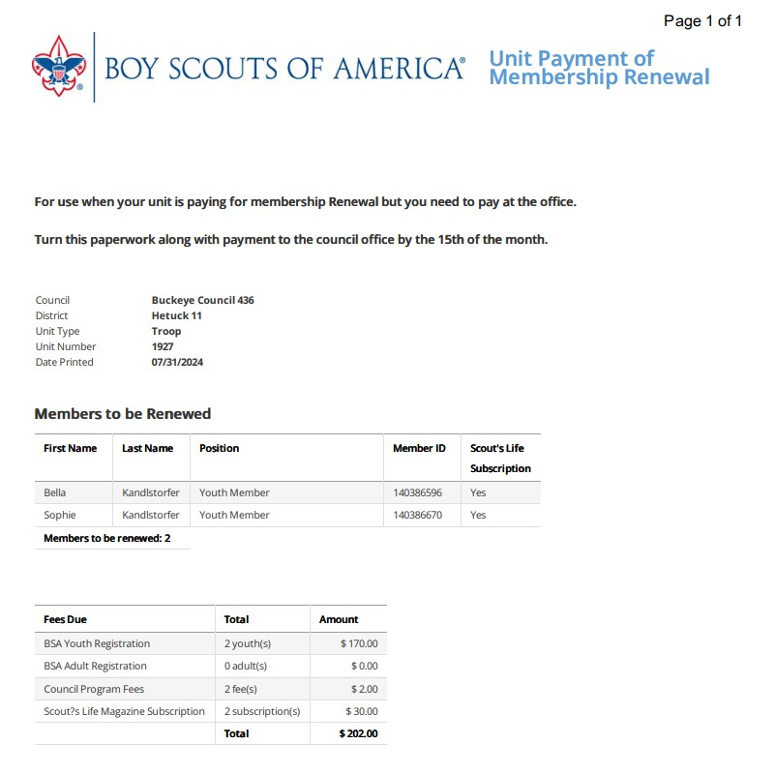

OPTION 2: UNIT RENEWS INDIVIDUAL (continued)
Individual Registration Renewal Process
WHEN PAYING DIRECTLY TO THE Atlanta Area COUNCIL
STEP 6: A popup will display that the paperwork is downloading
STEP 7: Submit this paperwork and payment to the Atlanta Area Council. See below for more details.
Deliver check, cash, or card along with this printout directly to the Atlanta Area Council Service Center, or mail to:
Atlanta Area Council
1800 Circle 75 Pkwy SE | Atlanta, GA 30339

Slide 20






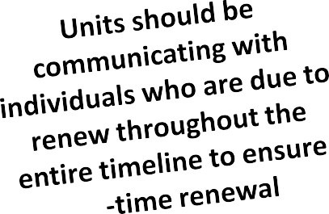
COMMUNICATION TIMELINE
Individual Registration Renewal Process
NATIONAL COUNCIL
60 days before registration expires
Individuals & unit leaders receive email from the National Council about the upcoming renewal
30 days before registration expires
Individuals & unit leaders receive email from the National Council about the upcoming renewal
Registration Expires
National Council will send emails notifying individuals of expiration
7 days after registration expires
National Council will send a second email to individuals with instructions to renew
30-60 days after registration expires
National Council will send a series of notifications reminding individuals of expiration and how to renew
*Timeline is subject to change

Slide 21

Individual Registration Renewal Process
FREQUENTLY ASKED QUESTIONS - MEMBER RENEWAL
What is the proper way to renew someone who has a multiple registration in another unit?
The best way is to have the individual renew themselves. That way they can renew all positions at once. If the unit chooses to renew them, then each unit must renew the member. Individuals who are multipled should tell all units which one they are paying with to be their “primary unit” to avoid overpaying.
What is the process to register two youth with the same adult partner if one is a Lion and another a Tiger? The unit should have the ability to assign the parent to more than one youth who is a Tiger or Lion when submitting their renewal. Parents of twins are an example.
We have a family needing registration assistance. How does that work?
The Atlanta Area Council offers registration assistance for all families who express a need. The District Professional for your area should work with you to complete the form and submit on your behalf.
Will it be possible to align all members of a family to one renewal date?
No. Registration terms are a set 12-month term from the date of registration.
What if there is a scout registered as a Crew member but also an adult leader in a Troop?
The Venturing Participant position in the Crew should be the paid position, with the adult position in the troop being a multiple position. This qualifies the members to attend any camps or events where youth registration is a requirement or allows them to work on any youth awards.
Can we pay for member renewals using a credit card at the council office?
We recommend paying with cash or check for all renewals to the Atlanta Area Council. Any credit card transactions will be charged a 3% credit card processing fee at the Atlanta Area Council. Debit cards do not incur a fee.
Still have questions or need help?
You can reach out to your District Professional (click here for our staff directory) , District Commissioner, Council Registrar (click here) or the Council Office (770-989-8820)
29

